Slide 1
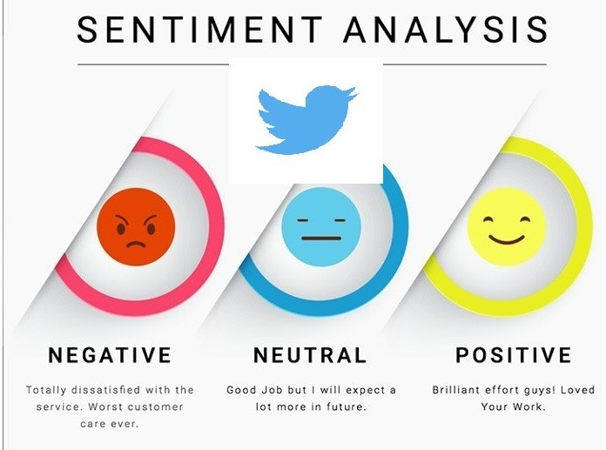
Twitter Feed Analysis
Presented By:
Name: Shyamashree Ghorai
Education: B.Sc. in Mathematics
from Calcutta university ,M.Sc. in Data Science
from Maulana Abul Kalam Azad University of Technology
Associated with Scifor Technologies

Slide 2
Introduction
Twitter Feed Analysis is a process of analysing the sentiment or emotion of tweets. We can classify tweets as positive, negative or neutral based on their content with the help of natural language processing and machine learning algorithm.
Some important aspects of twitter feed analysis are:
i) Customer feedback analysis
ii) Reputation management
iii) Political analysis

Slide 3
Proposed Methodology
The following steps to be implemented step by step :
DATA COLLECTION
Text Data
DATA CLEANING
Text Cleaning
SYSTEM TRAINING AND CLASSIFICATION
Random Forest
MODEL EVALUATION
Accuracy, Precision, Recall, F1-Score
OUTPUT

Slide 4
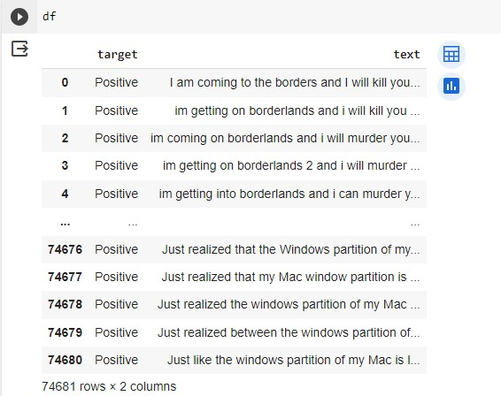
Dataset And Data Cleaning
Performed analysis on “Twitter Sentiment analysis” dataset (https://www.kaggle.com/datasets/jp797498e/twitter-entity-sentiment-analysis).
Dropped unnecessary columns.
Removed url, punctuations, html, retweet from text.

Slide 5
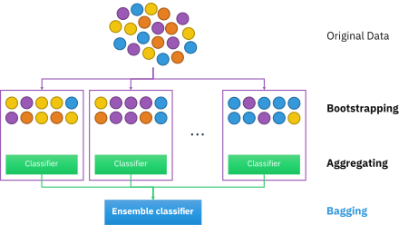
Model
Use Random Forest classifier as it can handle high-dimensional and sparse datasets, which is common in text analysis. Moreover, Random Forests are easy to implement and tune, as they have few hyper parameters and do not require much pre-processing or scaling of the data.

Slide 6
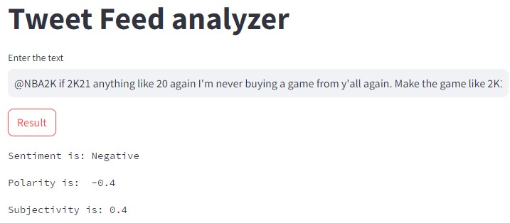
Output
Sentiment analysis is a NLP technique used to determine whether data is positive, negative or neutral.
Polarity refers to how positive or negative a text is, while subjectivity refers to how opinionated or factual a text is. Polarity score lies from -1 to 1. Subjectivity score lies from 0 to 1. Higher subjectivity score refers opinion rather than facts.

Slide 7
THANK YOU

